Slide 1

Profiles of Engineering & Engineering Technology, 2025

Slide 2
Note
I will post recording and materials from workshop on instructions page by COB tomorrow:
https://ira.asee.org/profiles-of-engineering-and-engineering-technology-instructions/

Slide 3
Agenda
Registration
Structure of the Survey
Timeline
Where on Campus to Find Information
Some common issues

Slide 4
Registration

Slide 5
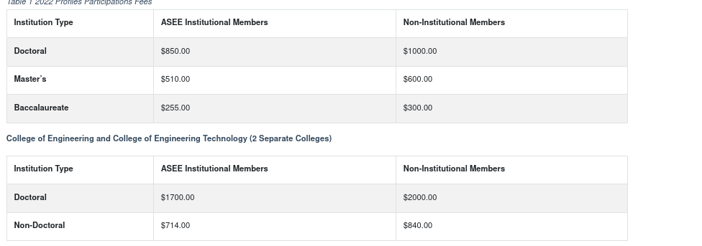
Registration
Before you begin– you’ll need to know the billing information for your participation fee, is your institution an ASEE member, the highest degree you award and are you reporting for two colleges (Engineering & Engineering Tech) or just one unit.

Slide 6
Structure of the Survey
Departments
Faculty (Tenured/Tenure-Track)
Teaching Research Personnel
Stipends
Research Expenditures
Degree Programs
Enrollment
Degrees Awarded
Degree Characteristics
Engineering Research Centers
Stipends
Research Expenditures

Slide 7
Reporting Period
Fall 2025: institution enrollments, engineering college enrollments, engineering technology college enrollments, faculty head counts, admission requirements and recommendations, and personnel information. If you need an as-of date for the data pull, please use November 1, 2025 (IPEDS) or your institution’s census date for courses.
July 1, 2024–June 30, 2025: Degrees awarded
Please report research expenditures based on your most recently completed fiscal year ending in 2025. Instructions and FAQ here: https://ira.asee.org/profiles-of-engineering-and-engineering-technology-instructions/research%20expenditures/
Please report student expenses for the 9-month academic year beginning in Fall 2025.

Slide 8
Go to Spreadsheet

Slide 9
Timeline
Full Instructions: https://ira.asee.org/profiles-of-engineering-and-engineering-technology-instructions/
Survey Opens: September 18. Institutions can register and begin filling out the survey. If you have participated last year, your data has been imported and used in the spreadsheet as well.
Spreadsheet/Flatfile Submission November 1. Beginning on this day, we will update the preview reports with spreadsheet data each week so institutions can have a final pdf of their data, as well as something to check before final submission. We will place the upload links here [COMING SOON!]
Data Preview reports available: December 15
Research Expenditures: For Institutions which plan on submitting data to US News for their ranking of engineering doctoral programs, we will begin to compare results submitted to ASEE with those submitted to US News prior to the close of the survey on January 15, 2026. Institutions can update their data before January 31, 2026.
Survey Close: January 31, 2026
Validation Period: February 1 to March 15. Institutions will be contacted to respond any questions ASEE IR&A staff have.
Preliminary Release Data in the EDMS: March 15. The EDMS will show 2025 data. Institutions will be able to update, as needed, until July 15, 2026. Data corrected after this date will not be reflected in the Profiles Publication. Data corrections for Profiles 2025 submitted after this data will be reflected in the EDMS (with a note on the change in the data log).
Final 2025 Data: August 15, 2026. All data will be available in the EDMS by this for Profiles 2025 including federal data on ABET accredited non-participating institutions for degrees awarded.
Engineering and Engineering by the Numbers published: September 2026.
Profiles Publication available to participating Institution: late September 2026.

Slide 10
Where to go on your campus for information
Enrollment/Degrees Awarded: Institutional Research
TT Faculty/Personnel Data: IR or HR
Research Expenditures: Business or Finance Office
If you participate in graduate USNWR, these are verified in mid-to-late January. https://ira.asee.org/profiles-of-engineering-and-engineering-technology-instructions/research%20expenditures/

Slide 11
Some Common Questions

Slide 12
Research expenditures
ASEE Engineering Research Expenditures: Dos and Don’ts (guidance approved in 2012 by ASEE Engineering Deans Council)
Do not count. . . .
. . . research expenditures for a lab/center solely because a faculty member is the lab/center director. Only externally-funded research that is expended directly by personnel and their work for the research mission of the school of engineering should be included.
. . . purchased equipment that enabled you to receive new awards. Only equipment that was purchased explicitly as part of and in support of a contract can be counted.
. . . required or not required cost share that the university or its affiliated foundation puts toward a project. This is considered internal funding whether it is via the university directly or one of its affiliates (e.g. a foundation).
. . . in kind gifts. These are not expended funds.
. . . waived indirect costs. These are not expended funds.

Slide 13
Research Expenditures (cont.)
Do not Count….
. . . research expenditures that are subcontracted to a party outside of your engineering college. Only include the research done by direct personnel of your engineering college. In the case of joint appointments, research expenditures are pro-rated in proportion to the effort in the school of engineering.
. . . discretionary spending that is appropriated from the dean‘s office. Discretionary spending is not considered to be externally-funded, regardless of the original source.
. . . any research that is funded from an endowment or a general fund. These sources are considered to be internal and therefore, should not be included, regardless of the original source. This includes general state appropriations, a percentage of which is presumed to be for the support of research.
. . . expenditures for marketing existing research results or either applying for or developing new research proposals. This is not considered to be research.
Do count . . .
. . . externally-funded expenditures associated both fundamental and applied research.

Slide 14
Research Expenditures
ECRs and Departments:
You can report expenditures by ECR, but if you indicate those expenditures are located in a department, they will not be counted to your total expenditures for USNWR to avoid double counting (The assumption if you report expenditures in a department, you are reporting them also in your department totals).

Slide 15
Two Disciplines
Department of Aerospace and Mechanical Engineering
Engineering with Specialization (B.Sc. in Engineering, but have specializations in CE etc.)
Two Options:
Select a single discipline that is closest to the program/department
If you want to report a more detailed faculty, enrollment, etc. report the department or program as two different unit with different names
  Department of Aerospace & Mechanical Eng. (Mechanical Eng.)
  Department of Aerospace & Mechanical Eng (Aerospace Eng).

Slide 16
Two Disciplines
B.S. Engineering (Civil)
B.S. Engineering (Mechanical)
DO NOT USE DIFFERENT CONNECTORS E.g.
  Department of Aerospace and Mechanical Eng.
  Department of Aerospace AND Mechanical Eng
  Department of Aerospace & Mechanical Eng
Our processing treats (a)-(c) as the same name.

Slide 17
Thank you!
Questions can be directed to data@asee.org

